Slide 1
Flight Prices Prediction and Recommendation Model
CIS 5560 - Term Project
Group 5

Slide 2
Introduction
Objective
To develop a predictive model that can accurately forecast flight prices
Importance
Customer Satisfaction
Airline Revenue Management.
Airlines - It enables optimal pricing strategies, adjusting prices based on demand and competition, which maximizes profitability and helps in better managing flight capacities and schedules

Slide 3
Data Source URLs
Dataset URL(6 GB):
GitHub Dataset URL:
GitHub URL:
https://www.kaggle.com/datasets/dilwong/flightprices
https://github.com/prathimasarvani/FlightPrices/blob/main/Flights_DataFile.zip
https://github.com/prathimasarvani/FlightPrices

Slide 4
SPECIFICATIONS
01
02
03
04
Memory Size: 390.71 GB
Number of Nodes
Cluster Version:
Hadoop 3.1.2
Spark 3.0.2
CPU Speed:
1995.3 MHz, 4 core CPU
5 Nodes
Command:
$hdfs version
$pyspark –version
Command: $lscpu

Slide 5
Project Scope
Predict flight prices column using various Pyspark Machine Learning Models.
Use hyperparameter and parameters tuning.
Use CrossValidation and TrainValidationSplit.
Comparing difference between models.
Build a Recommendation Model.

Slide 6
Architecture
Data Source
Data & Feature Engineering
Data Modelling
Data Validation
(Kaggle)
(Databricks, Zeppelin, Spark CLI, Vectorassemblers, Indexers, Pipeline, Hadoop HDFS
(Using Pyspark ML lib & tuning parameters with CrossValidation & TrainValidationSplit, etc
(Using binary & multiclass evaluation, estimators feature importance)

Slide 7
Data Source
Utilization of the 'Flight Prices' dataset from Kaggle, which includes comprehensive details on flight attributes (capturing various attributes like dates, origin, destination, and fare among others) and historical prices
We have considered columns such as Flight Date, Starting and Destination Airport, Airline Details, Fare Basis Code, Travel Duration to predicting total Fare.

Slide 8
Data & Feature Engineering
Handling missing values, modifying certain column values for algorithm compatibility, removing duplicates, and rectifying data inaccuracies.
Creating features
Feature Selection
Feature Encoding
Vector Assembler
Min Max Scaler

Slide 9
Data Modelling
Choosing a suitable algorithm to build a model
Parameter Tuning Setup
Cross Validation and Train Validation Split
Training and Evaluation

Slide 10
Data Validation
Choose the Best Model
Test Data Set to evaluate performance of the model.
Analyze the results by looking at performance metrics like RMSE – Root Mean Square Error, R2.
Even after deployment, models are often re-evaluated periodically against new data. This is important because the real-world data might evolve over time, causing the model's performance to degrade (a phenomenon known as model drift).

Slide 11

Machine Learning workflow

Slide 12
Flow Chart
Data & Feature Engineering
Train, Test & Validate
Evaluate
Gathering Data
Data Split
Identify project object & look for data sources
Split the data and prepare to train the model
Evaluate models by using measures for accuracy
Preparing the data for modelling
Train, Test & Validate the model

Slide 13
Machine Learning Algorithms used
Random Forest
Linear Regression

Slide 14
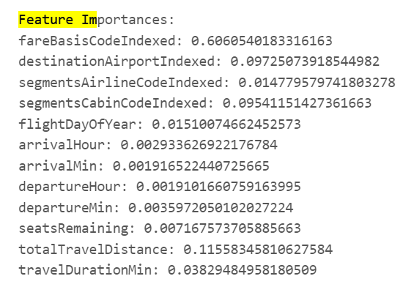
Feature Importance For RandomForest
FareBasisCode - (0.6)
This has the highest importance, suggesting that the
specific fare codes, which might encapsulate
information like refundability, advance purchase requirements, and other fare conditions, are the
most critical predictors of flight prices.
Total Travel Distance- (0.1):
This indicates the total distance of the flight, which is
a major factor in pricing as longer flights generally
cost more due to higher fuel consumption and other operational costs.

Slide 15
Parameters Tuning
Linear Regression – CVS
paramGrid = (ParamGridBuilder()
.addGrid(lr.elasticNetParam, [0.0, 0.5, 1.0])
.addGrid(lr.regParam, [0.01, 0.1, 0.5])
.build())
Linear Regression – TVS paramGrid = (ParamGridBuilder()
.addGrid(lr.elasticNetParam, [0.0, 0.5, 1.0])
.addGrid(lr.regParam, [0.01, 0.1, 0.5])
.build())
Random Forest – CVS
paramGrid = (ParamGridBuilder()
.addGrid(rf.numTrees, [10,20]) .addGrid(rf.maxDepth, [5])
.build())
Random Forest – TVS
paramGrid = (ParamGridBuilder()
.addGrid(rf.numTrees, [10,20]) .addGrid(rf.maxDepth, [5])
.build())

Slide 16
Comparing Models
Model Name | Accuracy(R2) | RMSE | Time
Linear Regression - TVS | 0.50 | 150 | 26min
Linear Regression - CVS | 0.50 | 144 | 45min
RF Regression – TVS | 0.86 | 77 | 18m
RF Regression - CVS | 0.91 | 56.55 | 146.6667m

Slide 17
Recommendation Model
Model | RMSE | R2
RF Regression – TVS | 56 | 0.91

Slide 18
Conclusion
After comparing all the models,
Random Forest Regression with TVS
This is the best fit models with least
Computation time and highest accuracy.

Slide 19
THANK
YOU

